Slide 1
Bioinformatics Bootcamp (Fall 2020)
November 10, 2020
RNA-Seq Alignment and Reads Quantification
Yu-Chiao (Chris) Chiu, Ph.D.
Greehey Children’s Cancer Research Institute

Slide 2
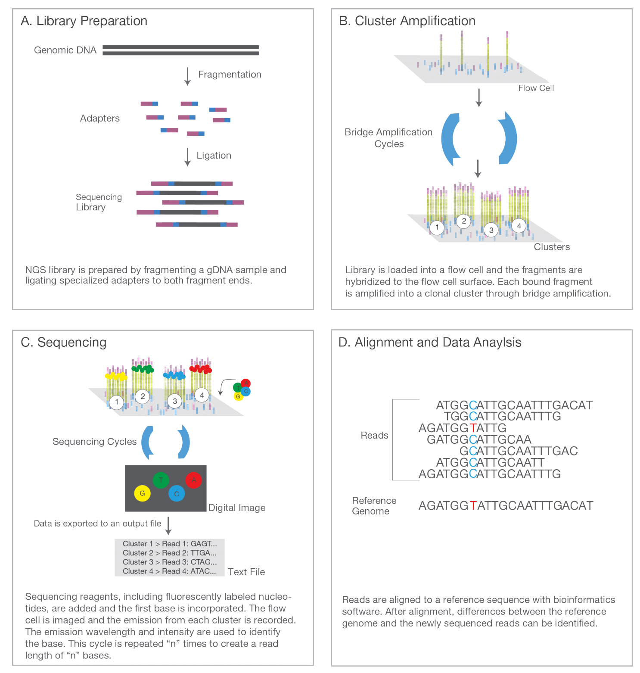
RNA-Seq
https://www.illumina.com/content/dam/illumina-marketing/documents/products/illumina_sequencing_introduction.pdf

Slide 3
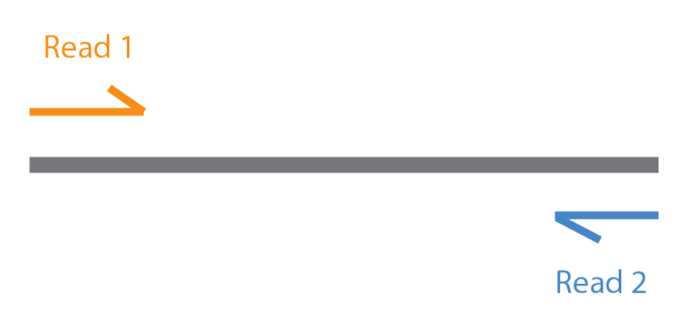
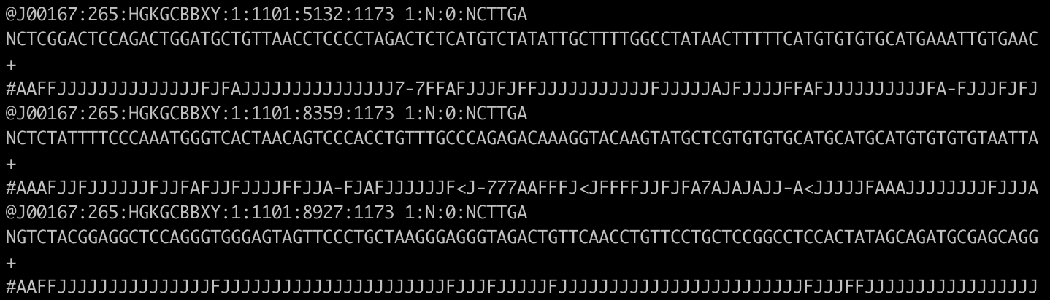
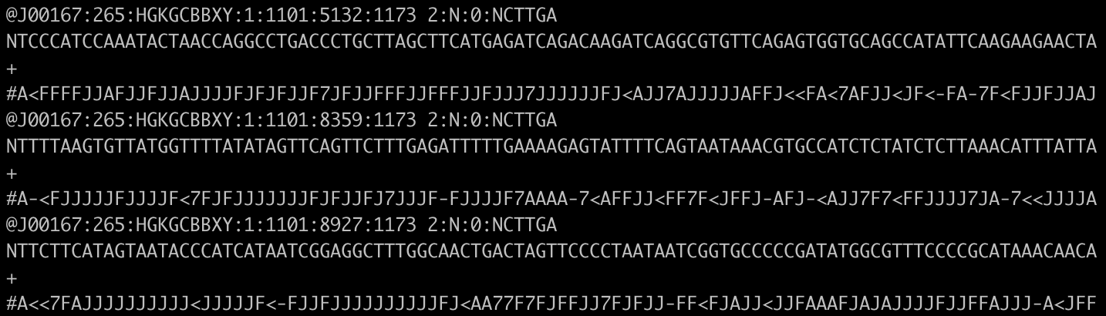
RNA-Seq raw data – fastq files
Paired-end sequencing
Sample_R1.fastq
Sample_R2.fastq
https://www.illumina.com/content/dam/illumina-marketing/documents/products/illumina_sequencing_introduction.pdf

Slide 4
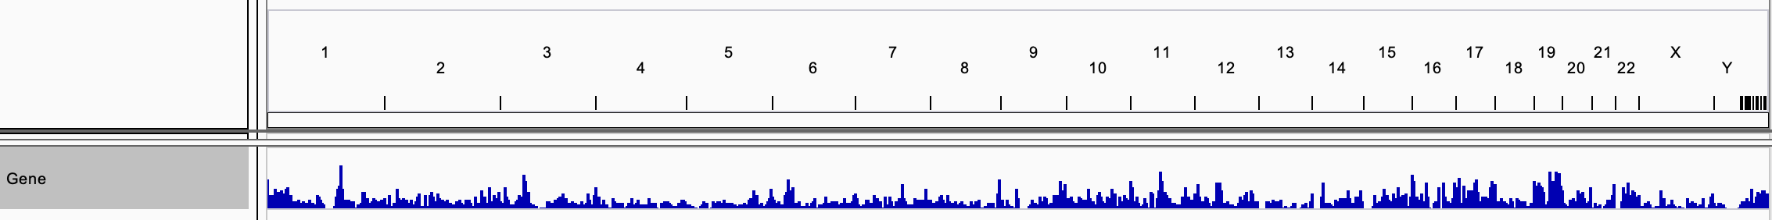
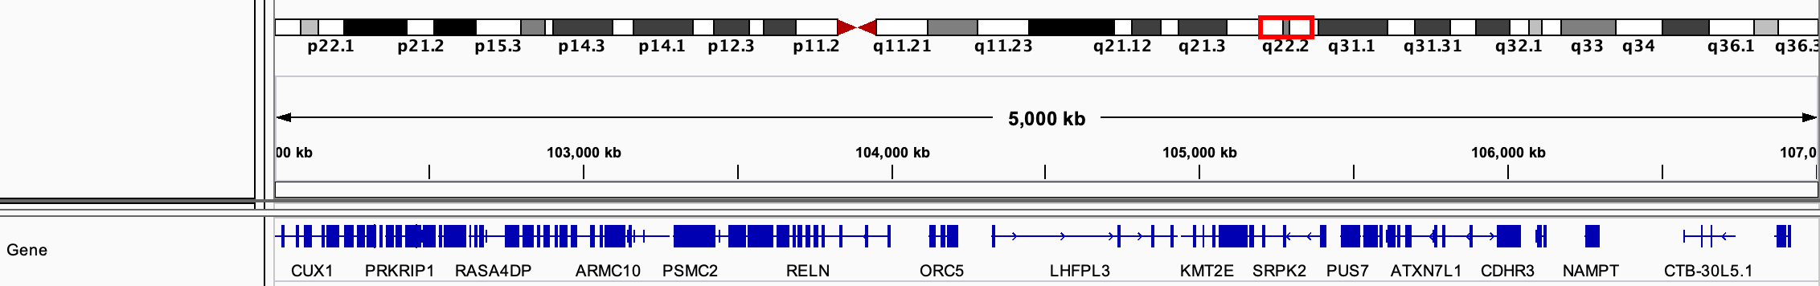
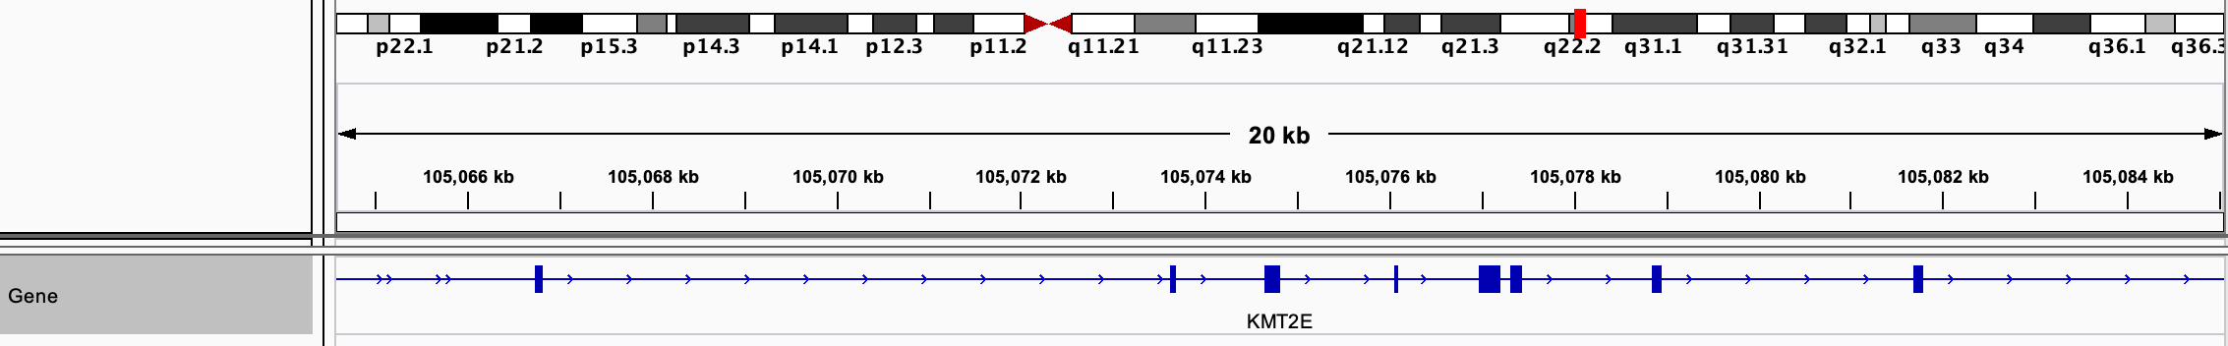
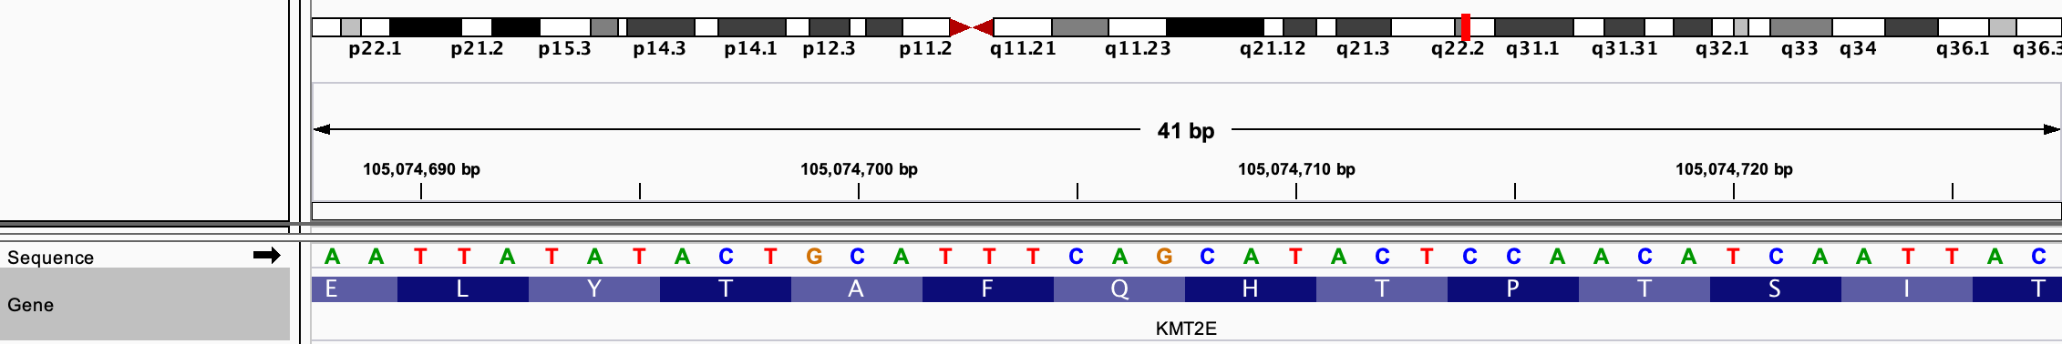
TCTGGAGAAACTGCTGCCTCATATCCGGGGGAATGTGGGCTTTGTGTTCACCAAGGAGGACCT
AAAACACCCAGAATCAAATACTGCTGGAATGGACATCTTTGCCAAATTCTCTGCATATATCAA
TCTCGATGGGCTTTCCAATGTCCTTTCCCCGGAGCTTGAGGCCAATGGCCCGCTCGATTTTGC
TGGGGGGGGCCGAGTCCCATTTCCTGTCATGGTCACAGTGGTTCCCACATTGATCTGTATGGG
TTCGGAATGAATGTTCATGGAAGAGGCTCCTCTGAGGGCAAGAGACCTGTTTTAGTGCTGCAT

Slide 5
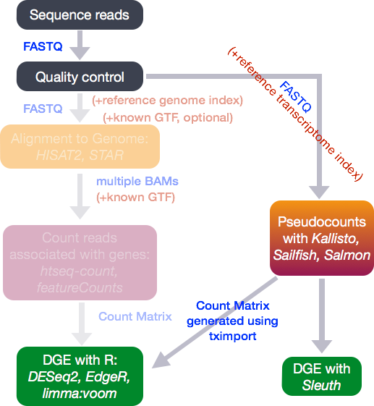
RNA-Seq Analysis Workflow
https://github.com/hbctraining/Intro-to-rnaseq-hpc-orchestra

Slide 6
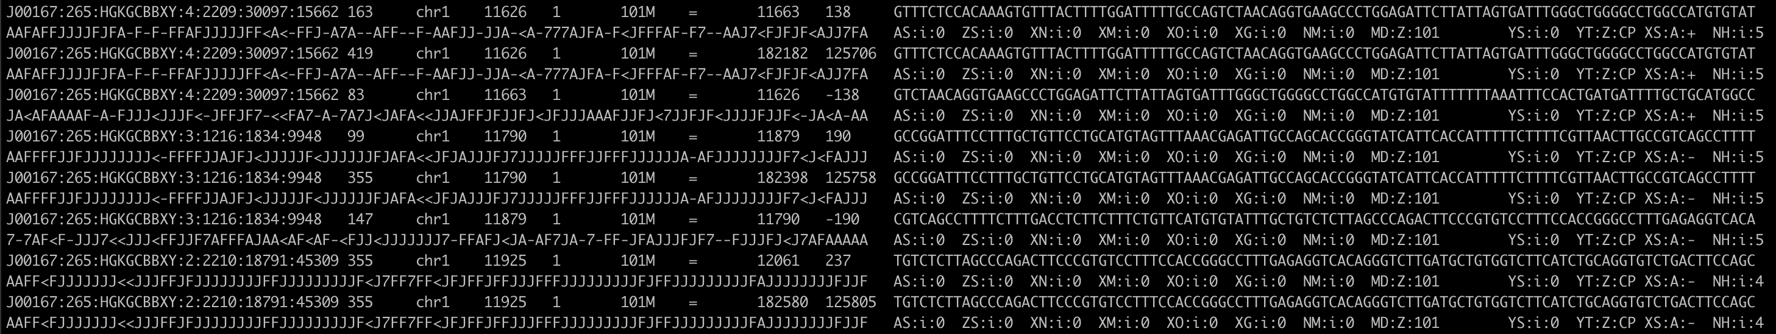
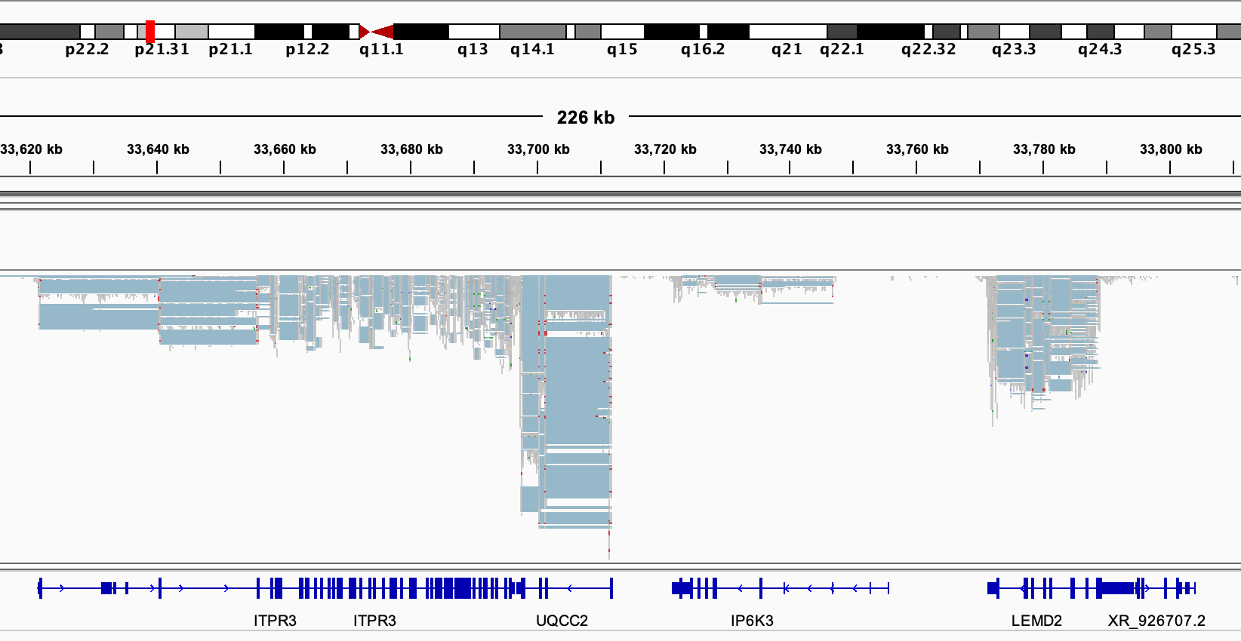
BAM files
Quantification based on BAM files

Slide 7
RNA-Seq Analysis Workflow
https://github.com/hbctraining/Intro-to-rnaseq-hpc-orchestra

Slide 8

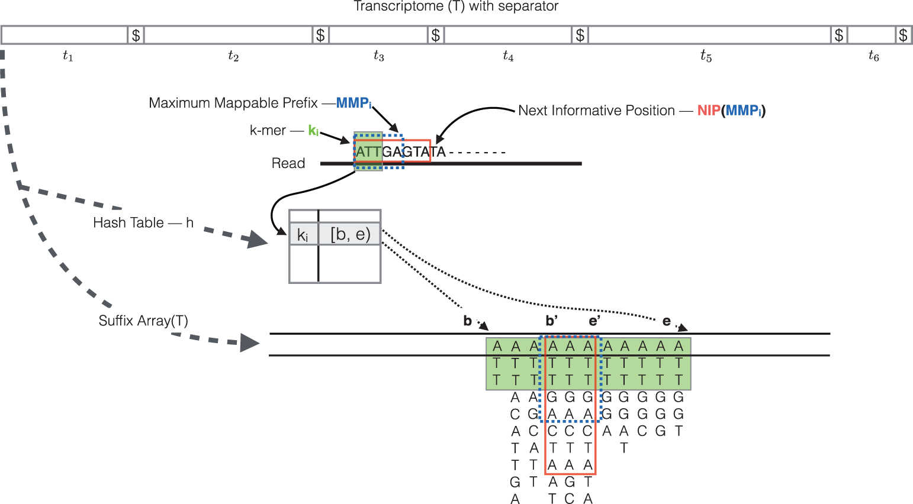
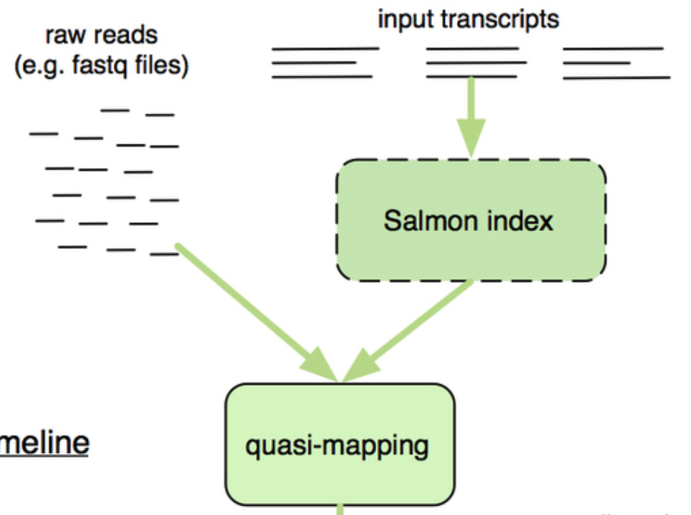
Quasi-mapping
https://combine-lab.github.io/salmon/
Modified from https://rna-seqblog.com/salmon-fast-and-bias-aware-quantification-of-transcript-expression/
Srivastava et al. Bioinformatics 2016.

Slide 9
Using Salmon on Linux…
*Relative/absolute path
*Functions and parameters
GEO link: https://www.ncbi.nlm.nih.gov/geo/query/acc.cgi?acc=GSE52778
SRA link: https://www.ncbi.nlm.nih.gov/sra?linkname=bioproject_sra_all&from_uid=229998
prefetch SRR1039523 --output-directory SRR1039523/
fasterq-dump -e 14 -p -O SRR1039523/ SRR1039523/SRR1039523.sra
salmon quant -l A -1 SRR1039523/SRR1039523.sra_1.fastq -2 SRR1039523/SRR1039523.sra_2.fastq -i hg38/salmon_partial_sa_index/default/ -p 14 -o Salmon.out/SRR1039523/
Documentation of Salmon:
Best practice recommended by Henry
salmon quant -h
salmon quant --help-reads
https://salmon.readthedocs.io/en/latest/salmon.html

Slide 10
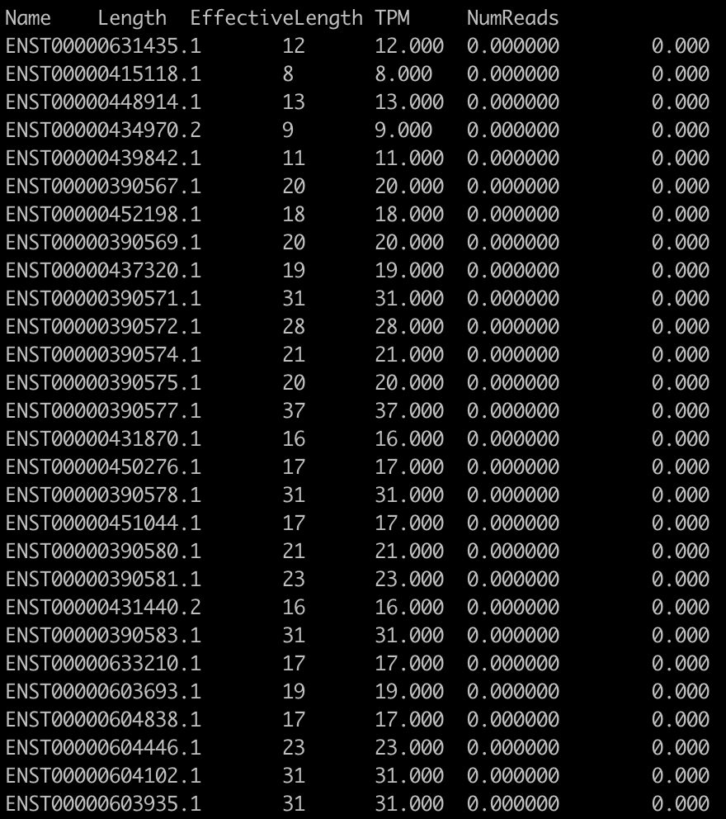
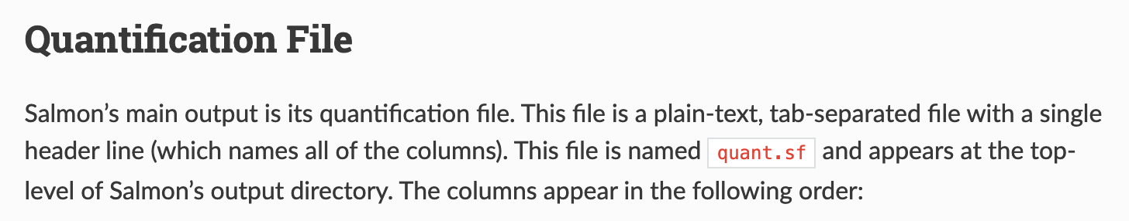
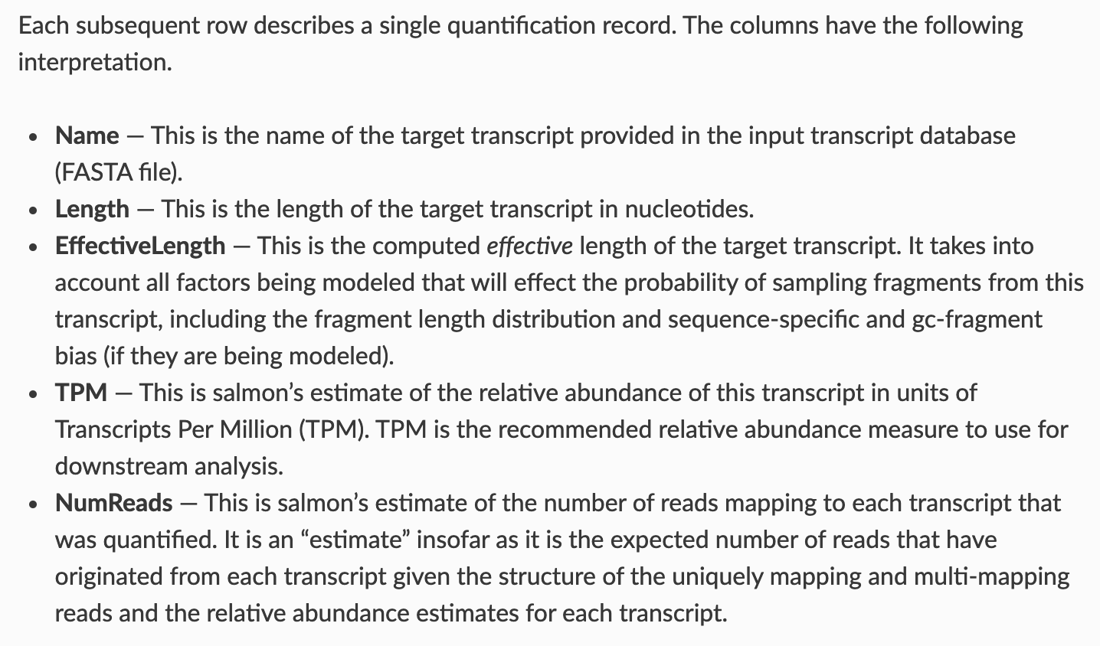
Results
https://salmon.readthedocs.io/en/latest/file_formats.html

Slide 11
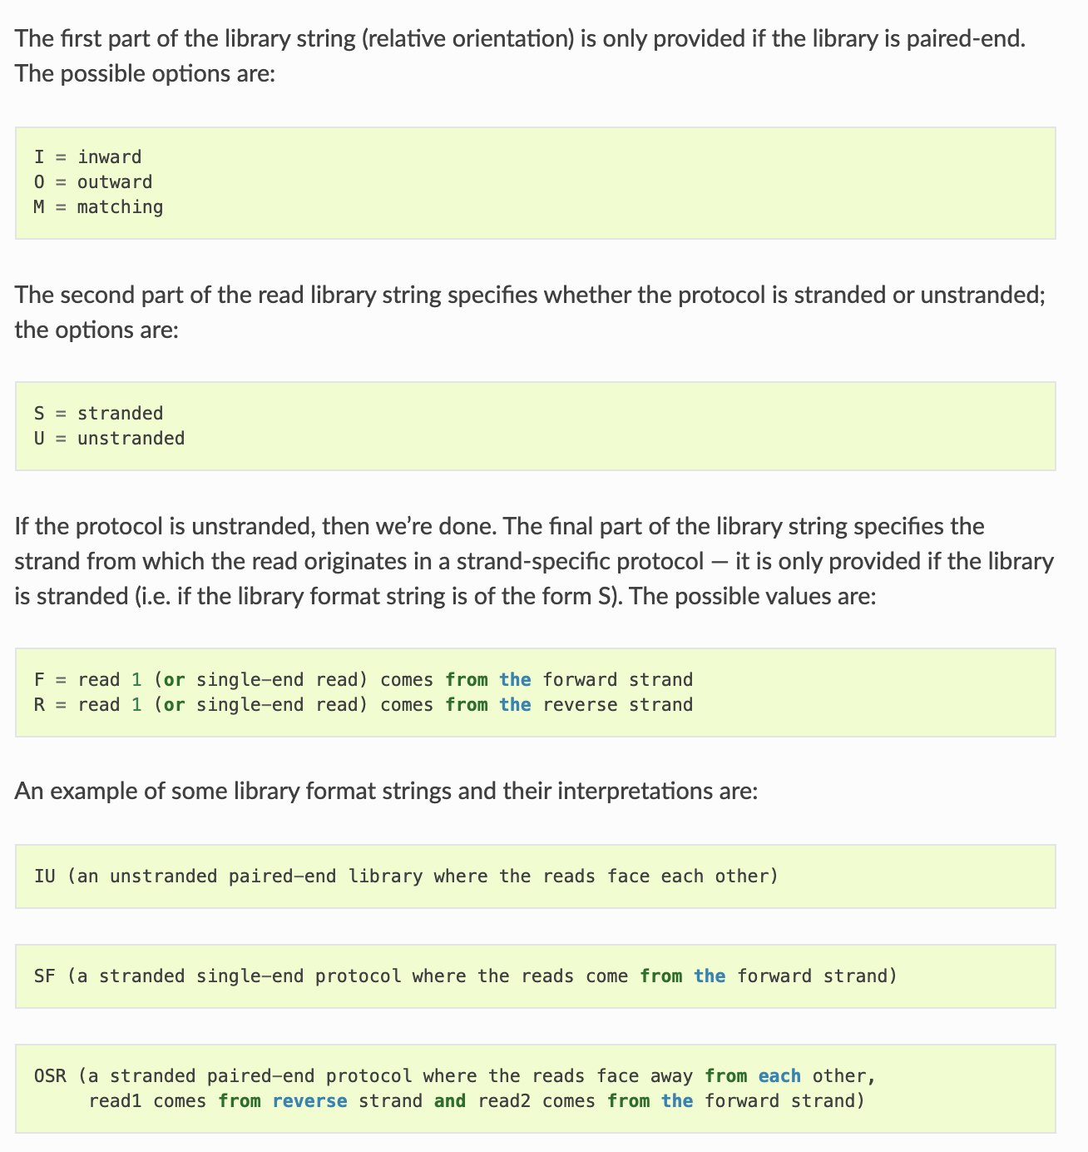
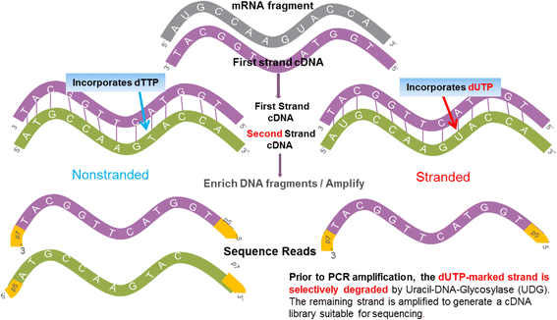
More Salmon settings
salmon quant -l A -1 SRR1039523.sra_1.fastq -2 SRR1039523.sra_2.fastq -i ../hg38/salmon_partial_sa_index/default/ -p 12 -o ../Salmon.out/SRR1039523/
Zhao et al. BMC Genomics 2015.
https://salmon.readthedocs.io/en/latest/salmon.html

Slide 12
More Salmon settings
https://www.illumina.com/content/dam/illumina-marketing/documents/products/illumina_sequencing_introduction.pdf
Single-end reads: salmon quant -i index -l A -r reads.fq --validateMappings -o out
Technical replicates:
salmon quant -i index -l A -1 lib_1_1.fq lib_2_1.fq -2 lib_1_2.fq lib_2_2.fq --validateMappings -o out

Slide 13
RNA-Seq Analysis Workflow
https://github.com/hbctraining/Intro-to-rnaseq-hpc-orchestra

Slide 14
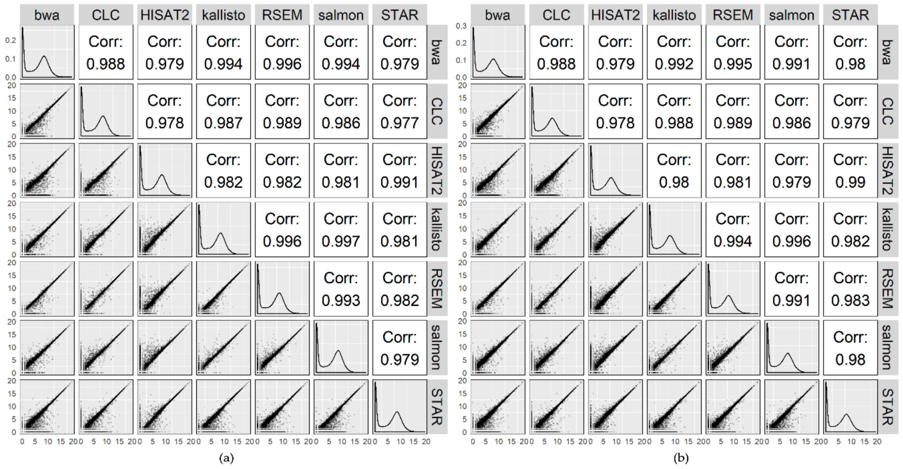
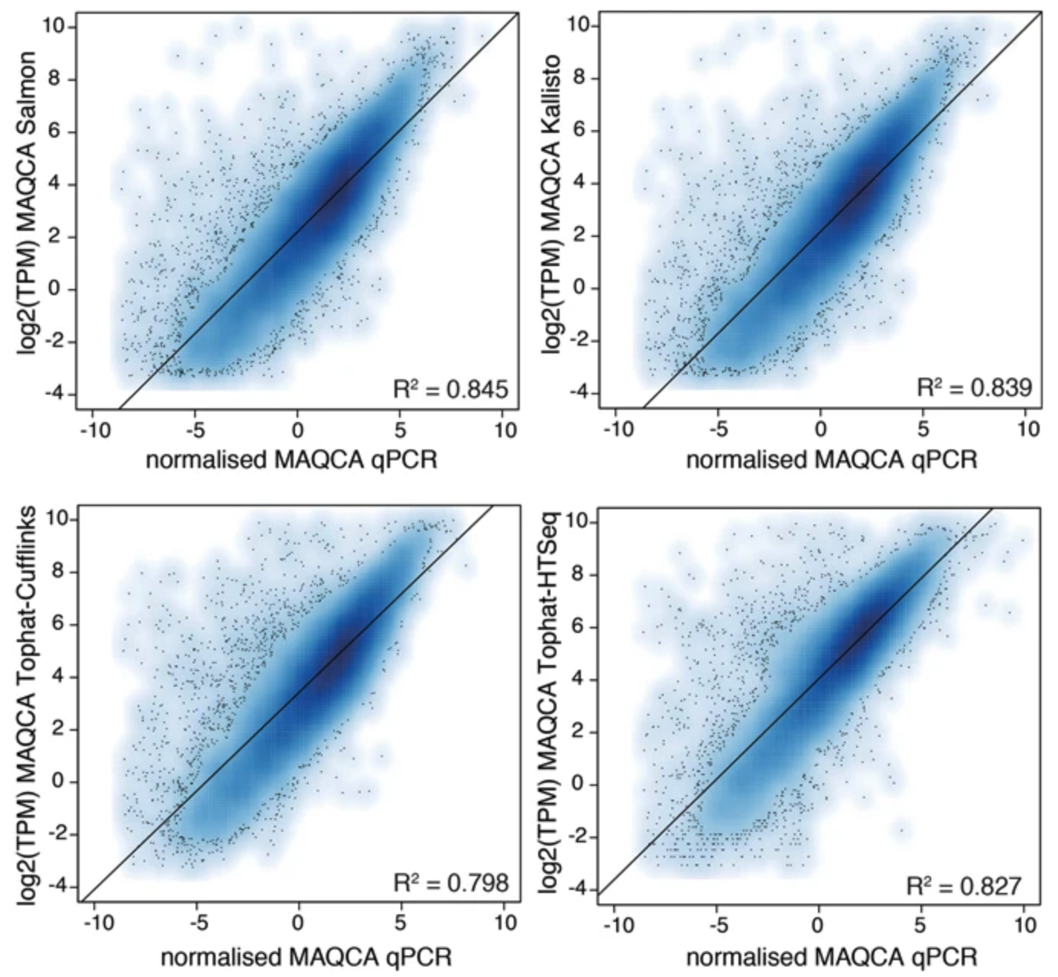
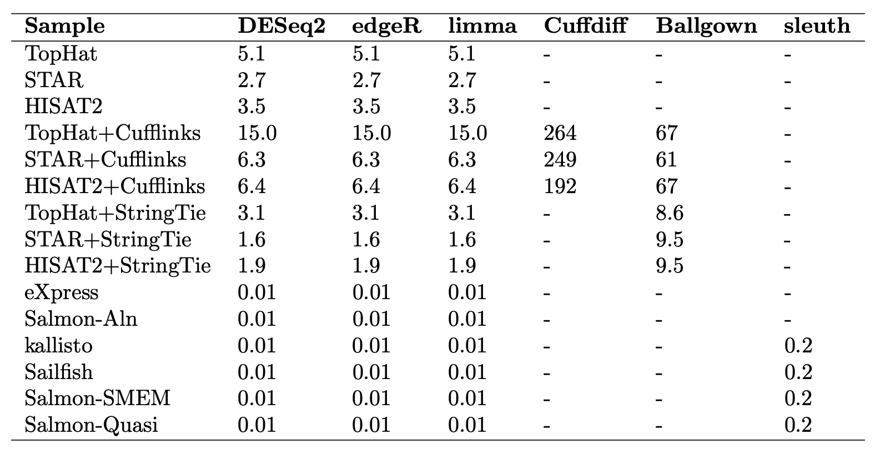
Comparisons between RNA-Seq aligners
Schaarschmidt et al. Int. J. Mol. Sci. 2020.
Everaert et al. Scientific Reports 2017.
Sahraeian et al. Nat Comms 2017.

Slide 15
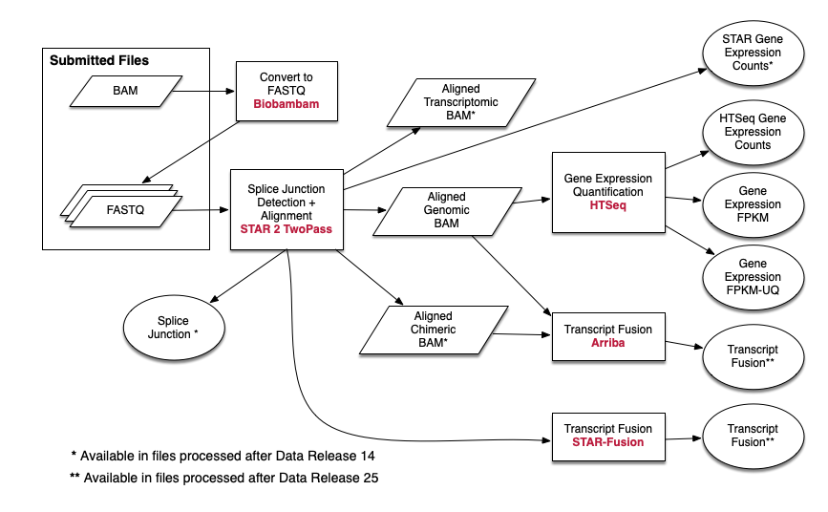
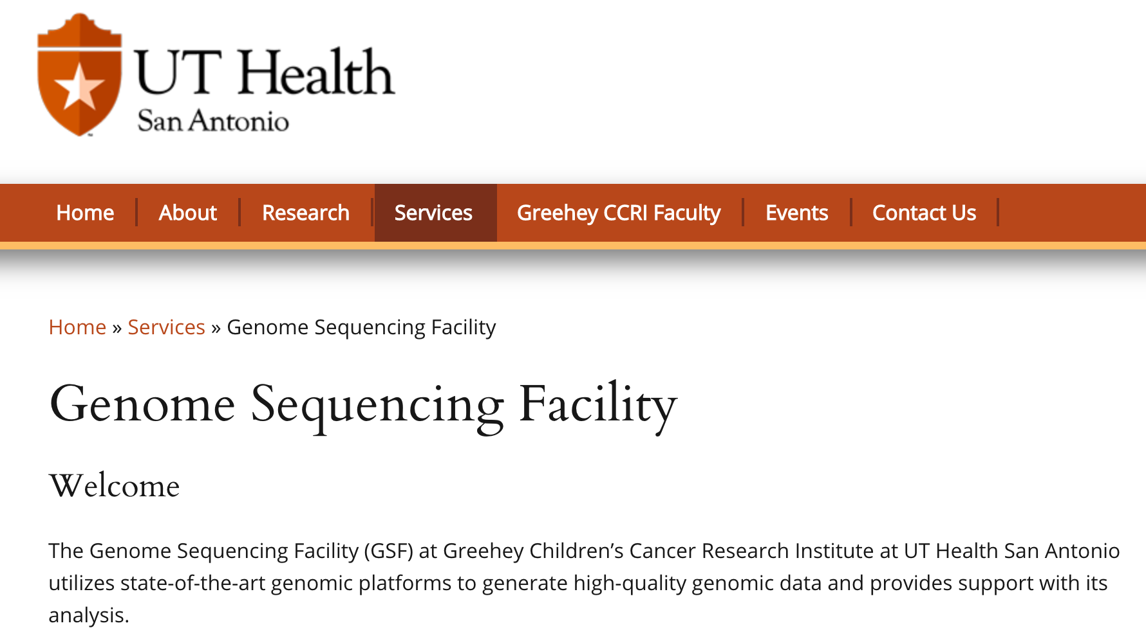
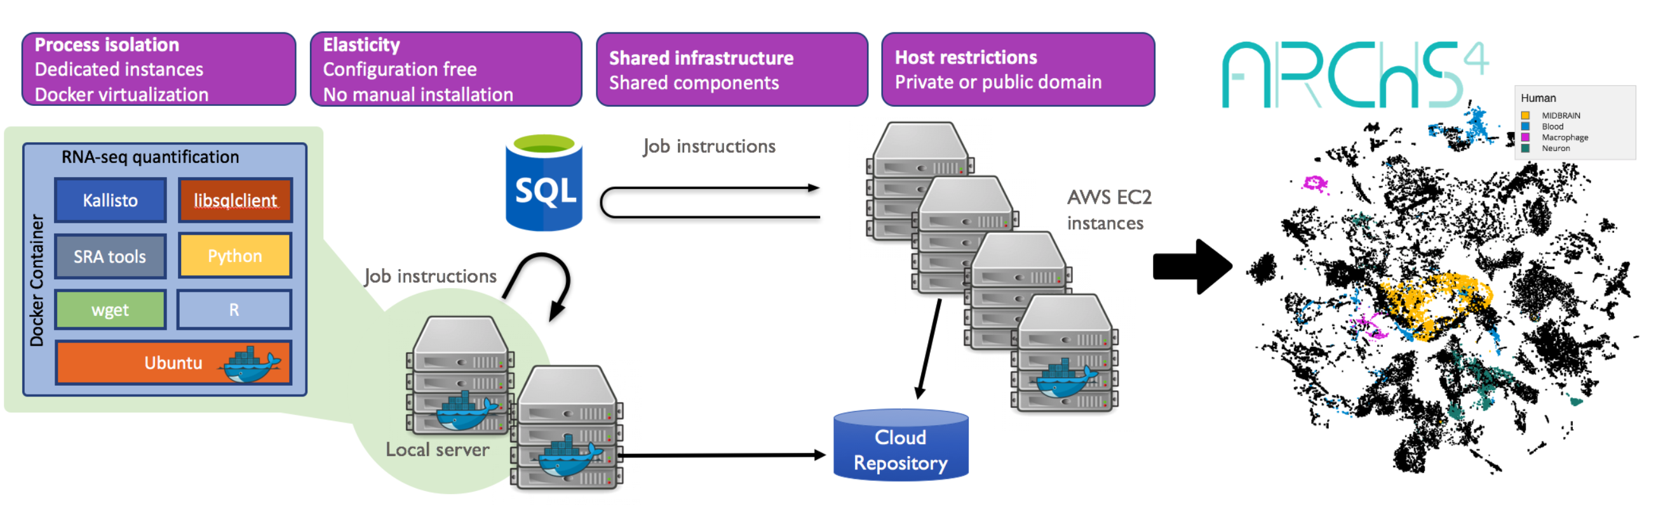
TCGA
TopHat2/HISAT2
RSEM
https://gccri.uthscsa.edu/services/genome-sequencing-facility/
https://docs.gdc.cancer.gov/Data/Bioinformatics_Pipelines/Expression_mRNA_Pipeline/
Everyone has a favorable aligner.
Different aligners may be optimized for (slightly) different tasks.
Make sure you use a standardized aligner and parameter settings for a study.
https://jhubiostatistics.shinyapps.io/recount/
https://amp.pharm.mssm.edu/archs4/

Slide 16
RNA-Seq Analysis Workflow
https://github.com/hbctraining/Intro-to-rnaseq-hpc-orchestra

Slide 17
Seq’s beyond expression quantification
Long-read RNA-Seq
Splicing, fusion, etc.
WGS/WES: SNV/indel calling, copy number, ChIP-Seq, etc.

